Slide 1
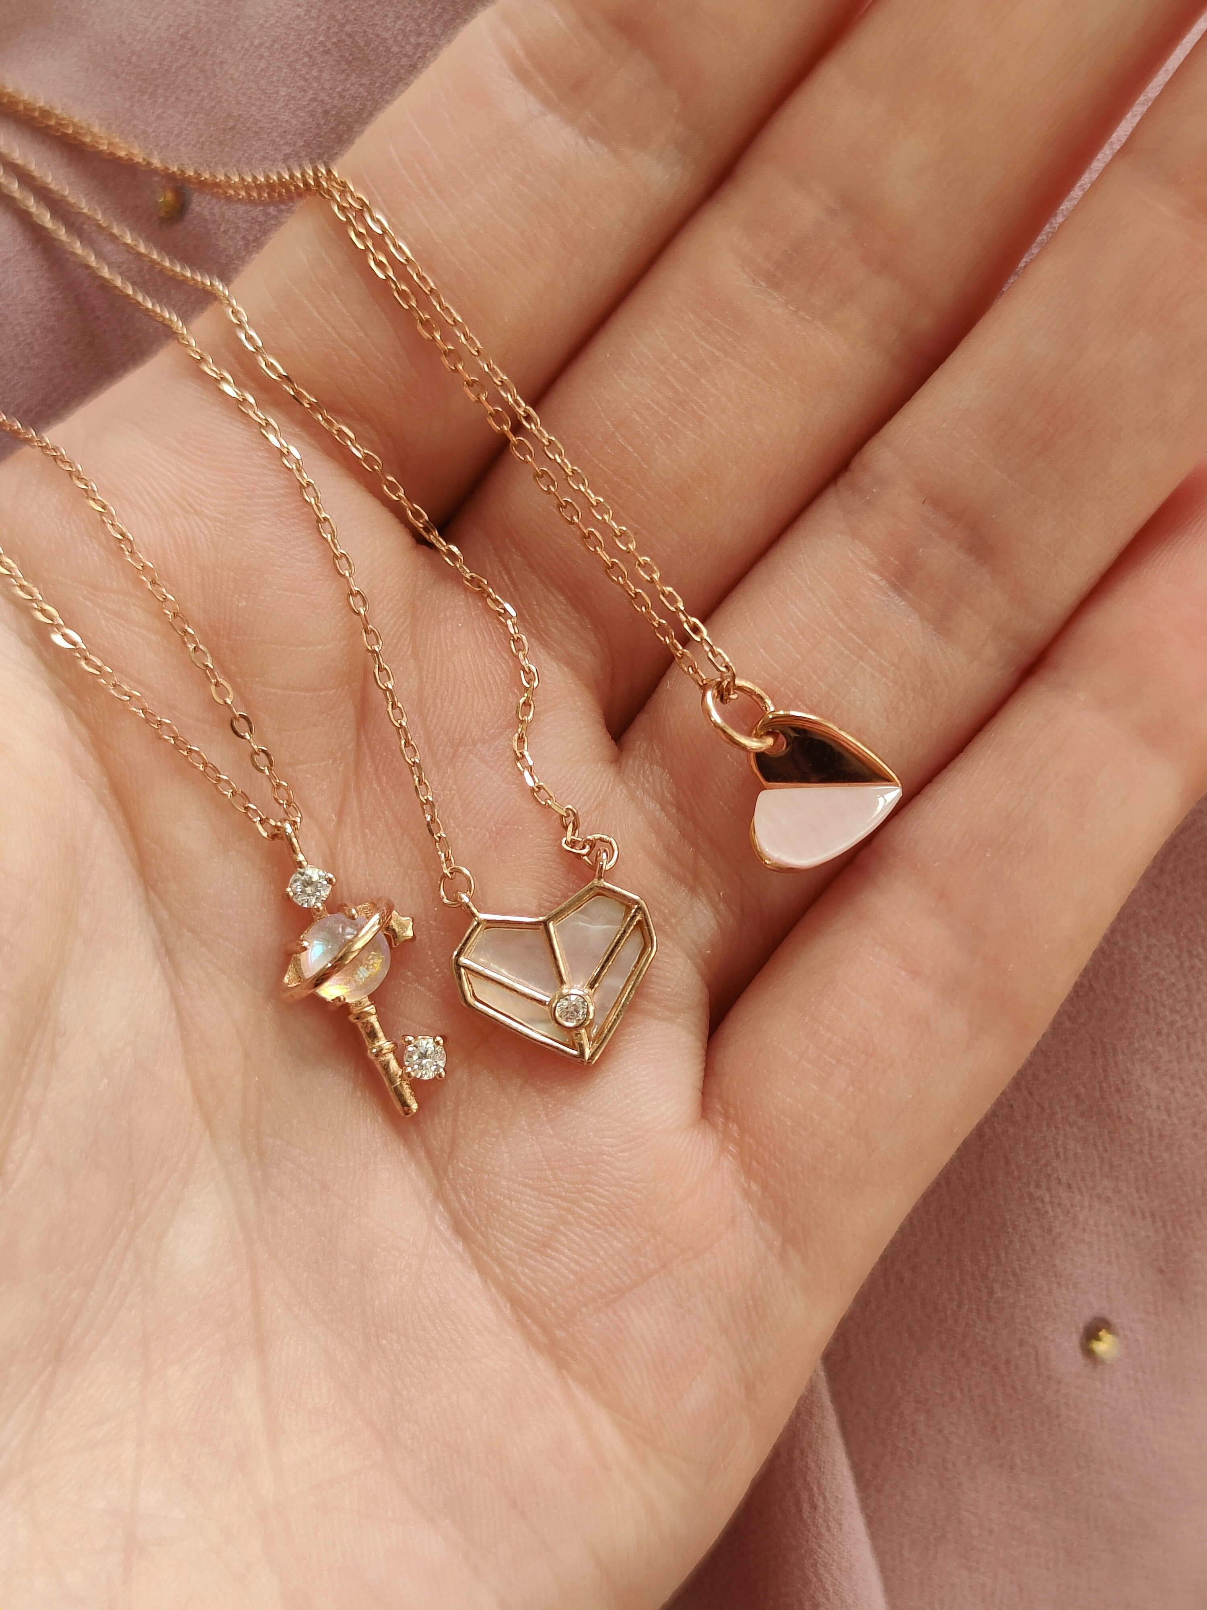
Leonora Jewels
“Where Jewelry Meets Technology – Virtual, Secure, Personalized.”
MERIN JOSEPH
VB23SWD026
SNEHA K A
VB23SWD034
GUIDE NAME: VISHNUPRIYA MISS

Slide 2
01
Introduction
My project is an ornaments e-commerce website designed to provide customers with a modern and engaging online jewelry shopping experience.
Unlike basic platforms, this website focuses on convenience, personalization, and trust.
02

Slide 3
Objectives
Enhance customer experience with features like, wishlist, and personalized recommendations.
01
Ensure secure and seamless transactions through UPI payments and reliable order tracking.
02
Simplify management for admins with dedicated dashboards and efficient order handling.
03

Slide 4
Core Features
Price Breakdown (Gold/Stone/Design Charges):Real-time gold/silver price integration to show live calculation.
Jewelry Certificate & Transparency Page:Each product linked to its authenticity certificate (purity, hallmark, diamond/stone details).
Outfit Matching Suggestions:Upload an outfit photo → system recommends ornaments that match colors & style.
Wishlist & Favorites for saving desired items.
Secure UPI Payments with dynamic cart-based pricing.

Slide 5
Personalized Recommendations based on user history.
360° Product View – allows customers to rotate ornaments virtually and see them from every angle for a realistic shopping experience
Occasion-Based Gifting Guide:Recommendations for anniversaries, birthdays, weddings, and festivals.
Gamified Loyalty Program:
Reward points for purchases, reviews, and referrals → unlock discounts or free gifts.

Slide 6
Insurance & Buy-Back Options:
Easy add-on for jewelry insurance and transparent resale/exchange policy.
Build Your Bridal/Custom Collection:
Customers create a wedding collection wishlist & share with family/friends.

Slide 7
Future Scope
AI-Powered Virtual Try-On using AR for more realistic fittings.
Voice Search & Chatbot Support for improved accessibility.
Loyalty Programs & Offers to increase customer retention.

Slide 8
Thank You

